Slide 1
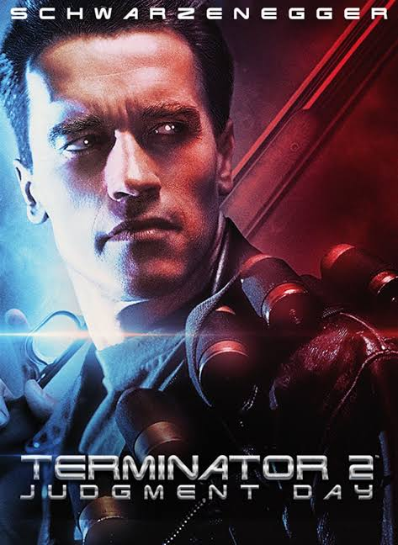
[Terminator 2: Judgment Day and The Terminator]
Cameron, J., Wisher, W., Schwarzenegger, A., Hamilton, L., Patrick, R., Morton, J., Furlong, E., ... Artisan Home Entertainment (Firm). (2003). Terminator 2: Judgment day. Santa Monica, Calif: Artisan Home Entertainment.
Notes:
Choose a movie portraying people interacting with technology ← THIS WILL LIKELY ALSO BE THE SUBJECT OF YOUR FINAL ESSAY, FEEL FREE TO CANVAS MESSAGE PROF. KNIGHT FOR EARLY FEEDBACK IF YOU WOULD LIKE… (leave a business day for my reply if you can)
Include an image relating to the film or ideas in the film.
Include the title of the film.
State a full citation of the film, including year and producer.

Slide 2

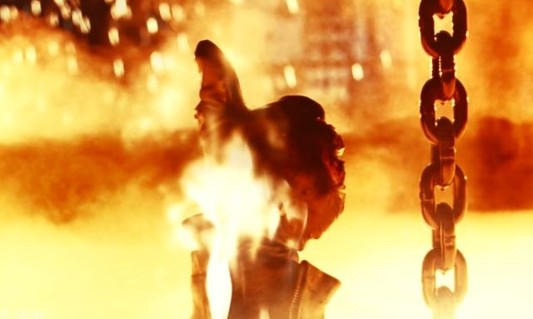
[movie title] Plot
[A terminator that has gone rogue (T-1000) with the ability to shape-shift has been sent into the future to kill Sarah's son, John Connor. However, the revamped T-800 has also been assigned and sent back to the future to protect John Connor. John Connor goes on to form a bond with the Terminator T-800 which anyone knows it is a killing machine. T-800 goes on a run to save humanity together with the young John Connor who Sarah Connor can describe as his Knight in shining armor. The movie ends with T-800 lowering itself into the molten steel after getting hold of T-1000. John begins to cry as the same takes place and movie ends with T-800 finishing its task with a thumb up which John ad taught him.]
(optional image 1)
Notes:
Choose a movie portraying people interacting with technology
Summarize the plot of the film in ~200 words, make sure to identify important characters and/or technologies you will reference later.
Include additional images

Slide 3
Ethical Issue (film)
The ethical issue explored include
Should we strive to fully develop and integrate AI into society? As seen from the Plot, Skynet, is a machine that has Artificial intelligence. Skynet directs its robotic integration against human beings to create a war that is none as Judgment Day. It creates T-1000 which is composed of liquid metal, that can manipulate, camouflage, shape shift to assume various forms. T-1000 is responsible for the Judgment Day to eliminate human beings from the face of earth.
AI is Imperfect — What if it Makes a Mistake?
Skynet was created by the US military as "Skynet-AI program", which would initially be used to automatically detect and coordinate defense strategy and outdo as well as outthinking any potential enemies. Skynet went on line on the
August 4th, 1997. It removed every human element devouring human decisions strategic defense. The system went learned itself on a geometric rate becoming self aware on the 2:14 a.m of Aug 29, 2013. This shows that AI can become imperfect.
If there is a chance that intelligent machines can be come Rogue Ais?
Skynet was initially created for a good purpose to protect the US from potential enemies but went rogue and the only way to stop was to stop it.
Notes:
Choose an ethical issue portrayed in the movie you watched:
In a bolded first sentence, identify and describe an ethical issue explored/exposed in the film (that relates to computer science!).
Next, provide background for this ethical issue (one paragraph). What was the original intention for the technology or concept behind the ethical issue?
Next, review the ethical issue in more detail given this background. Explore the positives and negatives.
Finally, talk about downstream impact. Were there unintended consequences? Why did it turn out in the way it did? Were there ways to have prevented what happened or, alternately, were there actions the characters took that helped in creating a positive outcome?

Slide 4
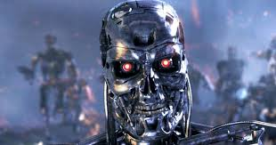

Ethical Issue (real-world)
Evil AI’s. How can we protect humanity against such unintended consequences?
From the Article and movie, it is very clear that AI’s can actually turn rogue. This means that we do not have to worry only about our adversaries who are fully covered by the AI’s created; but we also need to worry about ourselves(Bossmann, 2019). We need to view AI’s and other advanced systems as a genie in a bottle that can fulfill our intended wishes but can also can harm us if they can move out of the bottle. This is seen in the case of Skynet that goes rogue.
(image 1)
(image 2)
Notes:
Find an article that relates to the ethical issue that you analyzed in the previous slide:
Summarize the article and the real-world ethical issue (~100 words)
Describe how this real-world issue relates to the issue portrayed in the movie (~100 words)
Acknowledge how the real-world issue is also different from the film world (~50 worlds)
Add 1-2 images
Cite your source in the bibliography page.

Slide 5
Propose An Alternate Ending
Raising Fundd to increase AI safety: Using a similar like that of Elon Musk and PayPal co-founder Peter Thiel where they have both contributing to different foundations which all are aimed at studying safety mechanisms against technology. Peter Thiel has donated to Future of Life Institute an amount of $10m whereas Musk has also donated a number of times to various technology safety organizations. (Hvistendahl, 2019)
Arranging for Expo’s, improving collaboration across borders, and other similar events where AI threats can be discussed and measures taken: Just as climate change has been widely discussed and made a concern, the world needs to come together to discuss and create awareness about the risk of AI which is a threat to human survival.
Regulation and creation of policies that may stop AI threats as well as shifting AI priorities from threats to empower human beings and stay ahead in the race against robots. If AI development can be regulated through certification as well as ensuring AI development meets social and ethical fabric for the common good. (RAINIE & ANDERSON, 2019)
Notes:
Come up with three ideas for alternate endings that might address your ethical issue, for each:
Discuss the technology or policy solution that you are proposing
Describe the impact you think this change would have on your ethical issue and why (why is super important).
Are there potential negatives to this idea?
Why might it still be worth considering?
...in doing this three times you will have lots of options to get feedback of potential technology recommendations in your final paper!

Slide 6
References
Bossmann, J. (2019). Top 9 ethical issues in artificial intelligence. Retrieved 25 November 2019, from https://www.weforum.org/agenda/2016/10/top-10-ethical-issues-in-artificial-intelligence/
CAMERON, J., & WISHER, W. (1991). Terminator 2, Judgment day (pp. 1-318). [Place of publication not identified]: Applause Books.
Hvistendahl, M. (2019). Can we stop AI outsmarting humanity?. Retrieved 25 November 2019, from https://www.theguardian.com/technology/2019/mar/28/can-we-stop-robots-outsmarting-humanity-artificial-intelligence-singularity
RAINIE, L., & ANDERSON, J. (2019). Solutions to address AI's anticipated negative impacts. Retrieved 25 November 2019, from https://www.pewresearch.org/internet/2018/12/10/solutions-to-address-ais-anticipated-negative-impacts/
This Project’s Bibliography
Notes:
Using your bibliography tool of choice, add a bibliography for this project.
Each entry should include these items:
Author name
Title of the article
Publisher
Publish date
URL

